Slide 1


Plan Stack
By Salaudeen Surajdeen Bimbo

Slide 2

The Problem
Lack of Organization: Many people struggle with keeping track of their daily tasks, leading to missed deadlines and reduced productivity.
Overwhelming Complexity: Existing task management tools are often too complex, discouraging users from staying consistent with their to-dos.
Limited Accessibility: Users lack a simple, accessible, and intuitive solution that seamlessly integrates task tracking into their daily routines.

Slide 3
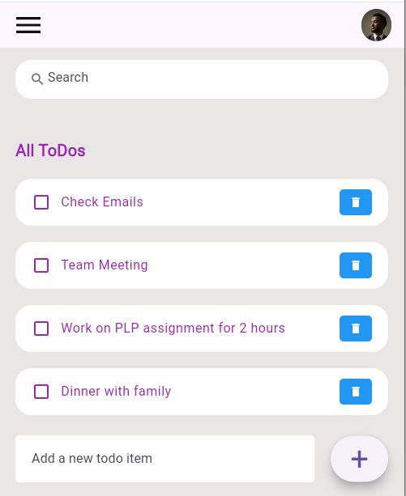
The Solution
The app provides a simple, intuitive platform where users can easily create, organize, and prioritize their tasks. With features like reminders, categorization, and progress tracking, it eliminates the complexity of task management. Its seamless design ensures accessibility on the go, helping users stay productive and focused in their daily routines.
“

Slide 4

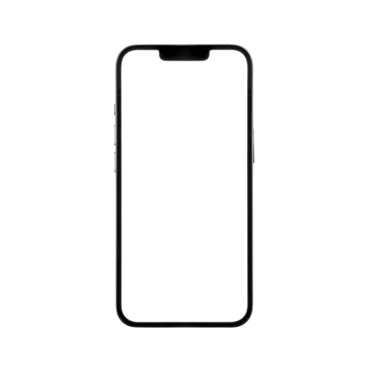
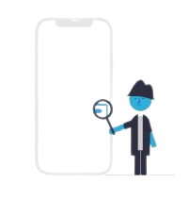

Product
Our product is
Mobile Based Application
1. Create tasks
2. Organize and Prioritize
3. Track and Complete Task

Slide 5
Target Market
Our target market consists of busy professionals, students and home managers
4 out of 5
People across various professions, lifestyles, and age groups struggle with task management, and the need to stay organized is universal. The app provides a simple solution to help users structure their day, manage priorities, and achieve goals.
81%
In today’s fast-paced world, individuals are increasingly looking for tools to improve their productivity and time management. The app meets this demand by helping users plan, track, and complete tasks efficiently.
72%
With smartphones becoming essential, people prefer tools they can access anytime, anywhere. A mobile-friendly To-Do app ensures flexibility for busy users on the go.

Slide 6
SOM
12%
Market Size
Total Addressable Market(TAM)
6.8 billions smartphones worldwide
SAM
28%
Serviceable Availability Market(SAM)
TAM
60%
A total of 6.8 billion individuals have access to mobile devices and the internet
Serviceable Obtainable Market(SOM)
4.2 billion potential users

Slide 7

Competitors
Todoist
Any.do
Our advantage: The main advantage of our app is its simplicity and privacy. It offers a user-friendly, minimalist design while prioritizing strong privacy protections, like end-to-end encryption and minimal data collection, which appeals to privacy-conscious users

Slide 8


Competitive Advantage
Competitive Advantage
Simplicity and Minimalism: Unlike feature-heavy apps like Todoist or Microsoft To Do, our app offers a streamlined design focused on ease of use. This minimalist approach would appeal to users seeking a straightforward, clutter-free tool for managing tasks, catering to those who find other apps too complex or overwhelming.
Privacy Focus: Unlike larger competitors like Google Keep or Microsoft To Do, which may track user data, our app prioritize strong privacy policies, minimal data collection, and end-to-end encryption. This would attract users who value privacy and want a secure, transparent task management app​

Slide 9
Project Traction
November
Week 2 - 4
December
Week 1 - 3
January
Week 2 - 4
February
Week 1 - 4
March
Week 1 - 2
Tasks
Market Research
Define Product Features
Create Prototype
Begin Development
Conduct Integral Testing
Launch MVP(Minimum Viable Product)
Monitor and Analyze User Engagement

Slide 10

Business Model
Subscription Based Model
Basic Plan: Core features available for free
Standard Plan: N 1,000
Premium Plan: N 5,000
Total Revenue per year = 1000 * 45 = N 45,000
Total cost per year = N 30,000
Profit Margin = (45,000 – 30,000)/100
= 32%

Slide 11

Go To Market
App Store Optimization
Referral Programs
Influencer Partnerships
Content Marketing
Social Media Engagement

Slide 12

Social Impact
SDG3: Productivity, Organization, and Privacy
Our app lies in its ability to help individuals better manage their time, reduce stress, and improve productivity. By offering a simple, user-friendly design, it empowers users—especially students and professionals—to organize their tasks effectively. Its emphasis on privacy also builds trust, contributing to a safer digital environment

Slide 13
Our Ask
We are seeking N4 million to fund the initial 12-month phase of our project. Investors can expect a 12% return on their investment after two years
Services Needed
Amount Per Service in Naira
Project Registration
N 100,000
Website Deployment
N 900,000
Branding and Marketing
N 1,500,000
Customer Support
N 300,000
Product Launching
N 700,000
Product Maintenance
N 1,000,000
Total
N 4,000,000

Slide 14
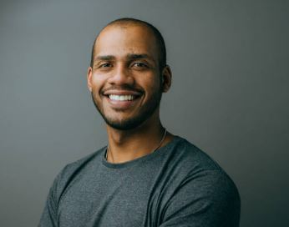



Team Members
Paul Madueke
Product Designer
Emmanuel Elem
Frond-End Developer
Ibukun James
Back-End Developer
Grace Anjorce
Marketer

Slide 15
Thank you !
Email: salaudinsuraj@gmail.com
LinkedIn
Portfolio

